Slide 1
European Hornets (Vespa crabro germana)
Huguenot Beekeepers Association
September 2016

Slide 2
European Hornet
Common in this area
Invasive species, but considered beneficial
Only TRUE hornets in the US
Bold Face Hornets actually a type of yellow jacket wasp
Likes to inhabit vacant bee hives/hollow areas
Nests have approx. 200-400 individuals
Gentle away from nest (can be held)
Aggressively defend it’s nest.

Slide 3
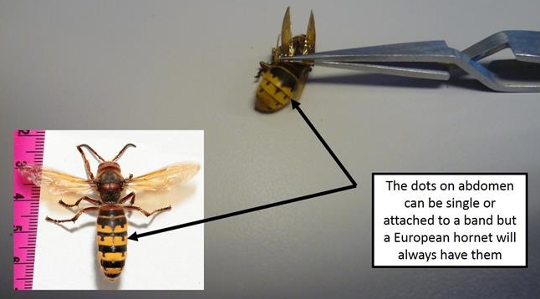
Distinguished from Japanese Hornet (Vespa mandarinia japonica) based on size, markings and behavior
No significant reports or official confirmations of Japanese Hornets residing in the Americas

Slide 4
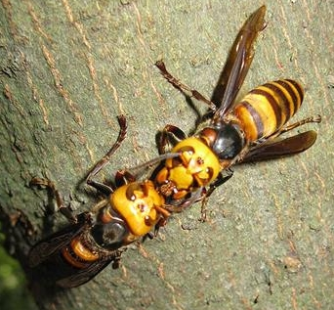
Japanese Hornet
Japanese Hornets will have only thick black bands on abdomen. Never appear to have dots.
The few documented sightings have been dismissed to misidentification or considered imported loners.

Slide 5
Japanese Hornet
Japanese Hornet will scout a colony, drop a pheromone marker and wait for backup before entering hive.
Once inside, all adult bees are dismembered and soft parts and larva taken back to hornet colony for consumption.
Asian honey bees are expert “ballers” and can usually eliminate scouts before signals are dropped.
European honey bees are not proficient at “balling” so efforts to repel attacks usually fail.

Slide 6
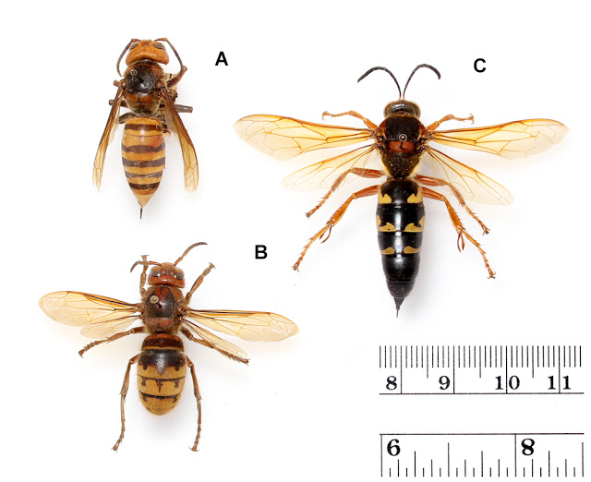
Sometimes European Hornet (B) and Japanese Hornet (A) are confused with bigger Cicada Killer which is also a wasp but not a true hornet.

Slide 7
European Hornet
Prefers large insect prey including crickets, grasshoppers, yellow jackets, etc.
Also found consuming tree sap and stripping trees of bark.
Considered minor nuisance pest of EHB.
Hover outside hive. Pick off incoming and exiting bees.
Extremely rare that they enter a hive.

Slide 8
European Hornet
Unlike Asian cousins, do not drop a signal pheromone resulting in total hive attack.
Do develop site memory and will often return to same location to pick-off individual bees.
Predatory behavior not significant enough to alter hive function unless the hive is in an extremely weakened state.

Slide 9
Summary
European Hornet, despite being a wasp and bee predator, is not a major threat to the colony as a whole.
Some research suggests an unintentional trade-off is occurring.
European Hornets take a few bee adults but also consume surrounding larger more adversarial prey.

